Slide 1
A tutorial on how (not) to over-interpret STRUCTURE/ADMIXTURE bar plots
Daniel Falush, Dan Lawson,
Lucy van Dorp

Slide 2
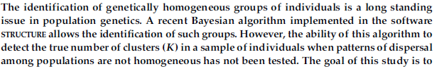
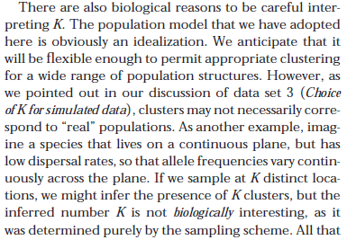
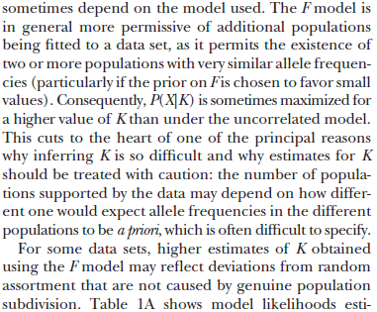

Slide 3




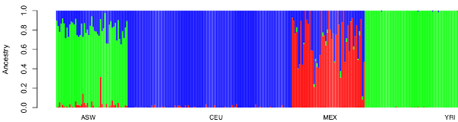
STRUCTURE/ADMIXTURE bar plots represent
ancestry proportions after recent admixture
African
Americans
West
Africans
Europeans
Hispanics
1000 genomes project

Slide 4
Genetic drift over
thousands of years.
F~0.1 (out of Africa bottleneck)
F~0
F~low
F~0.1 (reaching Americas)
West Africans
Europeans
Native
Americans
Admixture of
large populations
after 1500.
African Americans

Slide 5
Procedure for (over) interpreting STRUCTURE results
(1) Estimate K using a refined statistical procedure.
(2) Assume that at this is the true value of K.
(3) Assume each of the K ancestral population existed at some point in the past.
(4) Assume that modern individuals were produced by recent mixing of these ancestral populations.

Slide 6
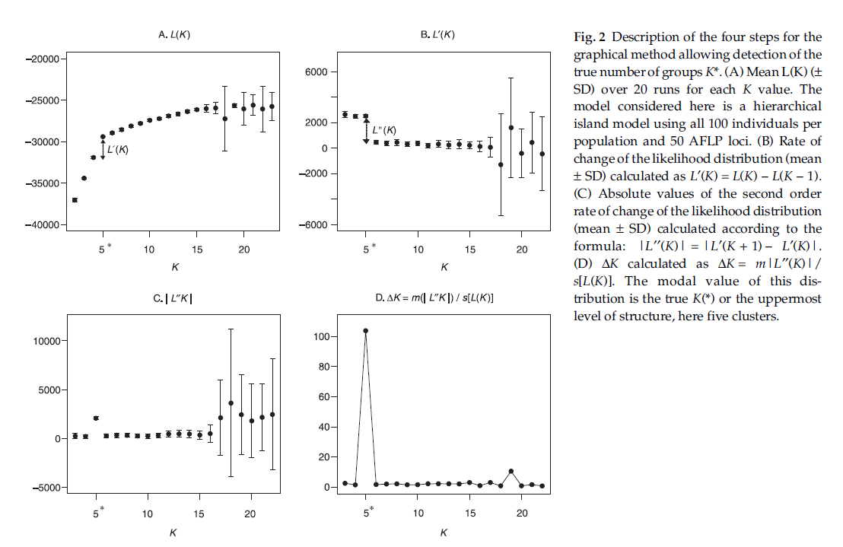
Procedure for (over) interpreting STRUCTURE results
(1) Estimate K using a refined statistical procedure.
(2) Assume that at this is the true value of K.
(3) Assume each of the K ancestral population existed at some point in the past.
(4) Assume that modern individuals were produced by recent mixing of these ancestral populations.

Slide 7
Treating ancestral population as atomic units
of inheritance
(3a) Do not ask how the inferred ancestral populations are related to each other.
(3b) Neglect the possibility an ancestral population might itself be admixed.
(3c) Neglect substructure within the inferred ancestral populations.
(3d) Label ancestral populations based on the locations they are currently most frequent in.

Slide 9
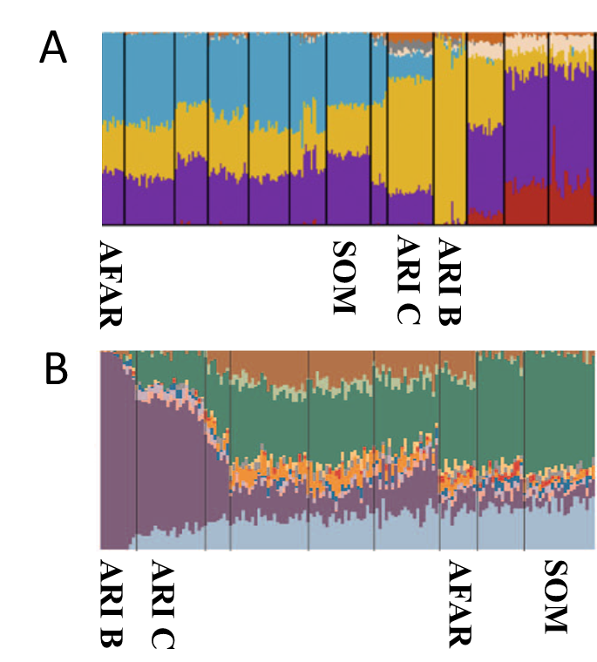
Three studies,
Three admixture plots,
Three colour schemes,
Three admixture histories,
Two interpretations.
C
ARI C
SOM
ARI B
AFAR

Slide 10
One insight provided by the ADMIXTURE plot (Figure 1C) concerns the origin of the Ari Blacksmiths. This population is one of the occupational caste-like groups present in many Ethiopian societies that have traditionally been explained as either remnants of hunter-gatherer groups assimilated by the expansion of farmers in the Neolithic period or as groups marginalized in agriculturalist communities due to their craft skills.51 The prevalence of an Ethiopian-specific cluster (yellow in Figure 1C) in the Ari Blacksmith sample could favor the former scenario; the ancestors of this occupational group could have been part of a population that inhabited the area before the spread of agriculturalists.
As the Ari Blacksmiths have negligible EthioSomali ancestry, it seems
most likely that the Ari Cultivators are the descendents of a more
recent admixture between a population like the Ari Blacksmiths and
some other HOA population

Slide 11
ADMIXTURE results for three simulation scenarios
Recent admixture
into Ari Cultivators
Ghost admixture
into Ari Cultivators
Strong drift in
Ari Blacksmiths

Slide 12
Chromosome painting
(Lawson et al. 2012)
Painting panel
Focal
chromosome
6
2
1.0
3
0.5
palette
0.0

Slide 13
Idea: compare admixture profiles with painting palettes

Slide 14
Under a recent admixture scenario, the palette of a admixed individual should be a mix of the palettes of non-admixed individuals
N individuals
P Labelled populations
K Ancestral populations
X=N*P
Individual
palettes
M=K*P
Palettes for
ancestral
populations
A = N*K
Individual
admixture
proportions
Choose M to minimize AM-X.

Slide 15
Recent admixture
into Ari Cultivators
Ghost admixture into
Ari Cultivators
Strong drift in
Ari Blacksmiths

Slide 16
Painting while ignoring linkage

Slide 17
Real data

Slide 18
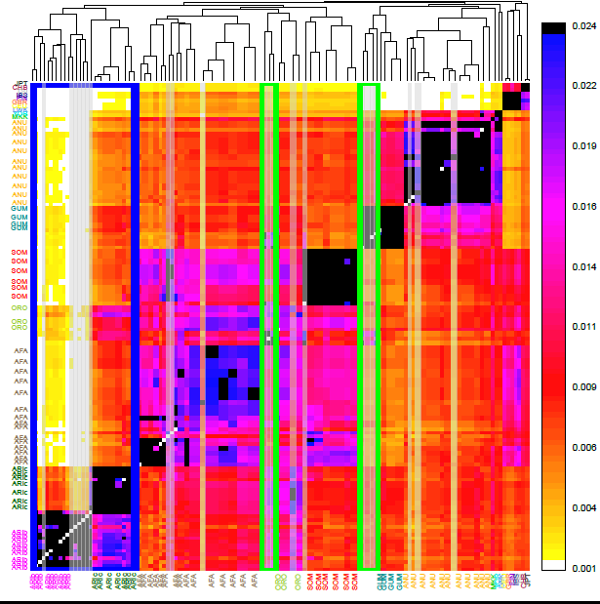

Slide 19
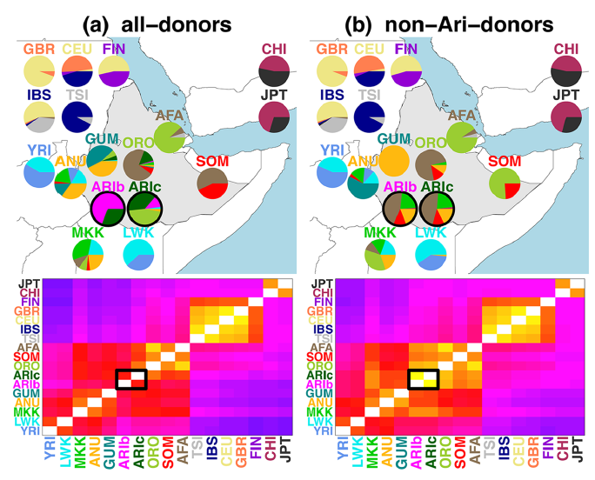

Slide 20
Fun with sampling
(0) Make sure to over-sample your favorite group.
(2a) If your favorite group does not have its own population, increase K until it does.

Slide 21
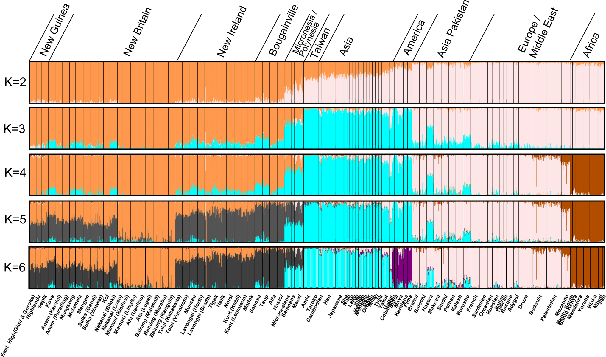
Friedlander 2008

Slide 22
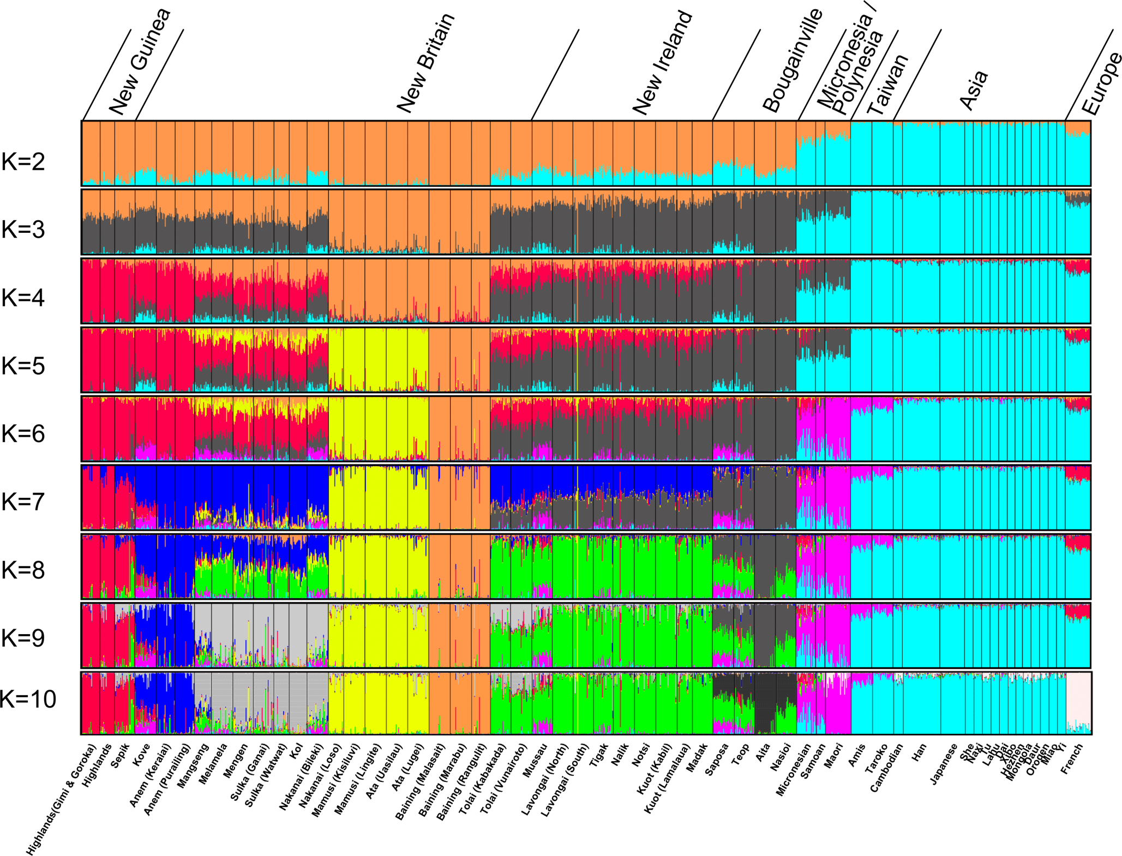

Slide 23
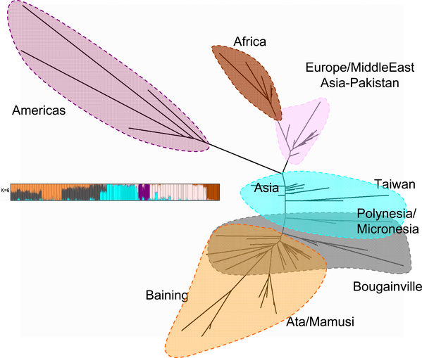

Slide 24
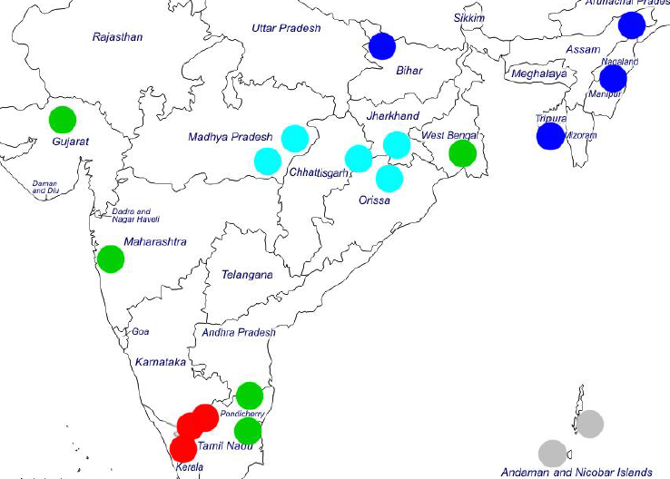
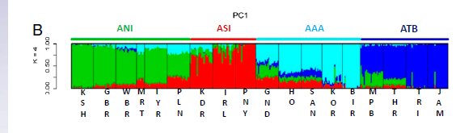

Slide 25
ASI
AAA
ANI
ATB

Slide 26
ASI
AAA
ATB
ANI
A
B
C
D

Slide 27
Conclusions
STRUCTURE/ADMIXTURE bar plots widely over-interpreted
Mixed ancestry profiles do not imply admixture
Recent genetic drift causes populations to be estimated as pure
Be alert for possibility of ghost admixture
Palettes can be used to visualize model fit and provide richer history
Provides a good starting point for population genetic analysis
Fitting and plotting procedure will be available from www.paintmychromosomes.com

